Slide 2
What Is Hinamatsuri?
Hinamatsuri (ひなまつり) is a special celebration recognised in Japan annually on the 3rd of March. On this day, platforms covered with red material display a beautiful set of dolls, which are ornamental and traditional in style.
These dolls represent the Emperor, Empress, attendants, musicians and ministers or protectors of Japanese royalty. The display traditionally represents a wedding from the Heian period.
Also known as Girls’ Day or Dolls’ Day, parents display these dolls to pray for the health and happiness of their daughters. Japanese people also celebrate by playing games, singing songs, and enjoying special foods and desserts.

Slide 3
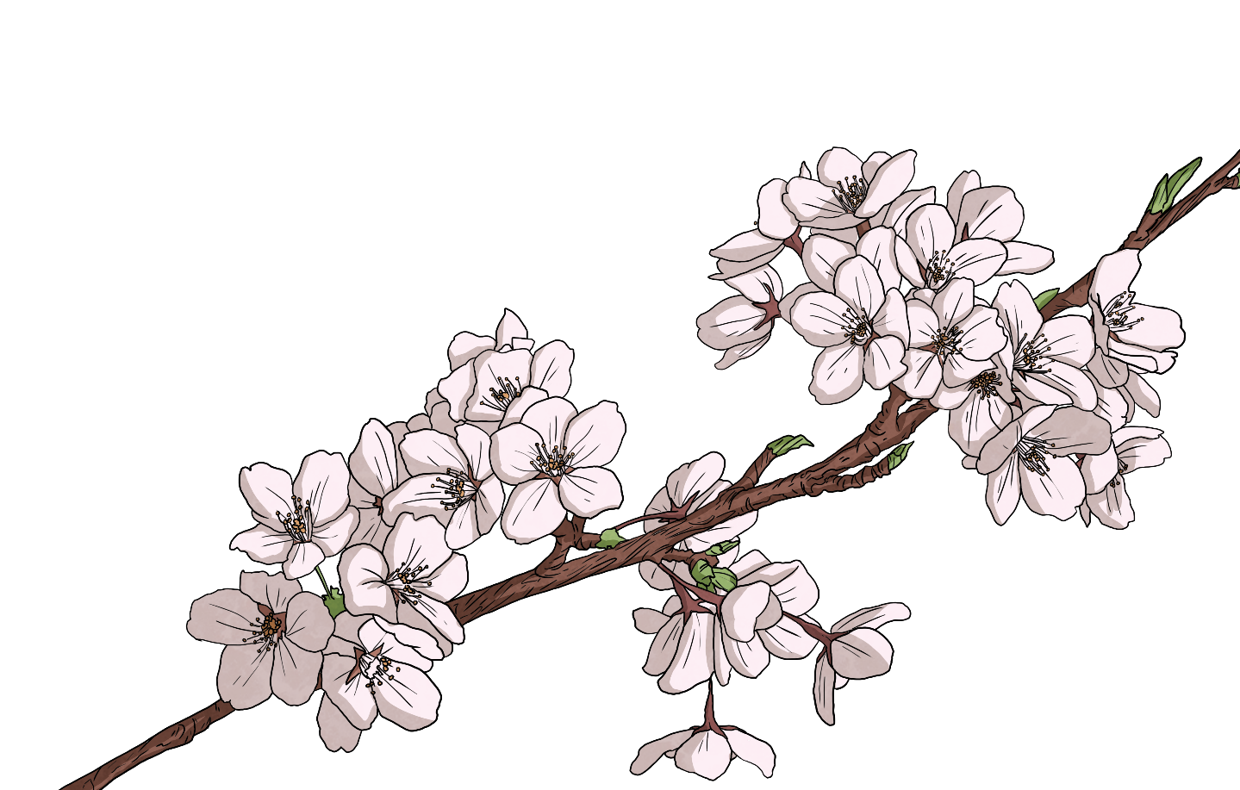
History of Hinamatsuri
Hinamatsuri is one of five seasonal festivals, known as go-sekku (ごせっく；五節句) from the Chinese calendar. Originally held on the third day of the third month, the date has been fixed in the modern calendar for the 3rd of March every year.
The festival was originally known as the Peach Festival or Momo no sekku (もも：peach; せっく：festival) as peach trees displayed beautiful flowers around this time. In modern times, peaches are still considered to be a symbol of this festival. They are displayed as decorations due to their beauty and belief that they ward off evil spirits.

Slide 4
Hinamatsuri Dolls
Hinamatsuri dolls are the most recognisable feature of this festival, and can range from simple folded paper dolls to expensive and detailed three-dimensional dolls.
The most important dolls are the male and female dolls, known as the odairisama (おだいりさま) and the ohinasama (おひなさま). Some displays, depending on how elaborate they are, will also include a tiered stand known as a hinadan (ひなだん) with additional dolls that represent three court ladies (三人かんじょ), five musicians (五人ばし) and other accessories. This entire set of dolls is known as the hinakazari (ひな：doll; かざり：decoration).

Slide 5
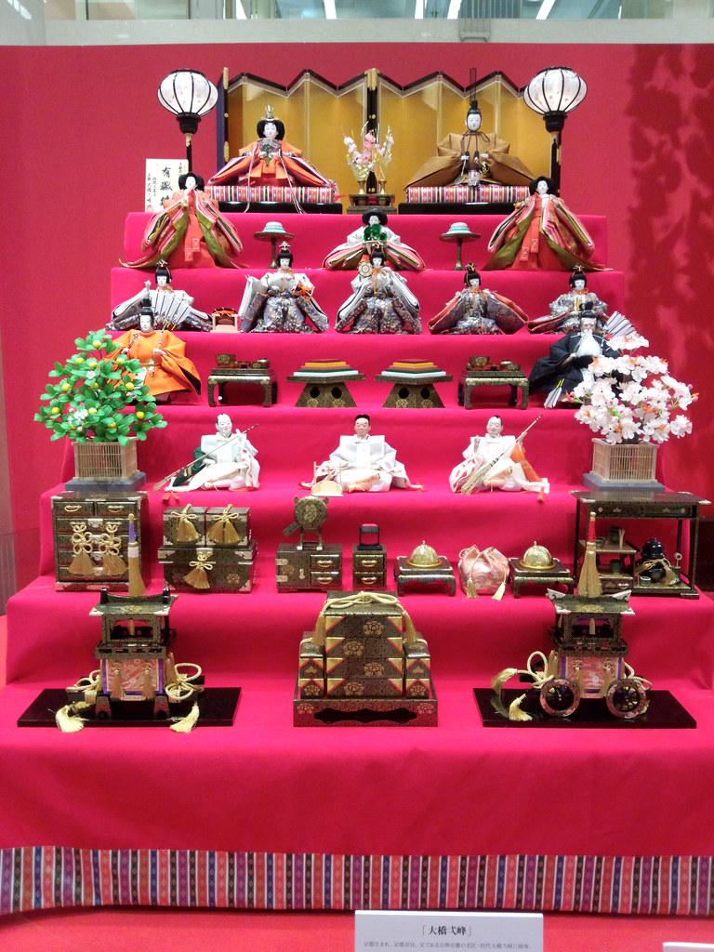
Top Platform: Imperial dolls
Second: Court ladies
Third: Male musicians
Fourth: Guardians/Ministers
Fifth: Helpers/Protectors
Sixth: Items used in palace
Seventh: Items used away from palace
“Japanese Doll Festival, Girls' Day: Hinamatsuri, Kyoto； ひな祭り、ひな人形、京都” by [Nullumayulife] is licensed under CC BY 2.0

Slide 6
Hinamatsuri Dolls
Families will usually obtain a new set of two main dolls before their daughter’s first Hinamatsuri, traditionally from the parents or as a gift from the grandparents.
It is also common for other relatives or friends to gift a newborn baby girl with other dolls or accessories for her display. A full set of dolls is expensive, ranging from $1000 to $2500, so they may be passed on from older generations as an heirloom.
The hinadan is seen as a cultural treasure and is often one of the most valuable possessions in the home, cherished by all members of the family.

Slide 7
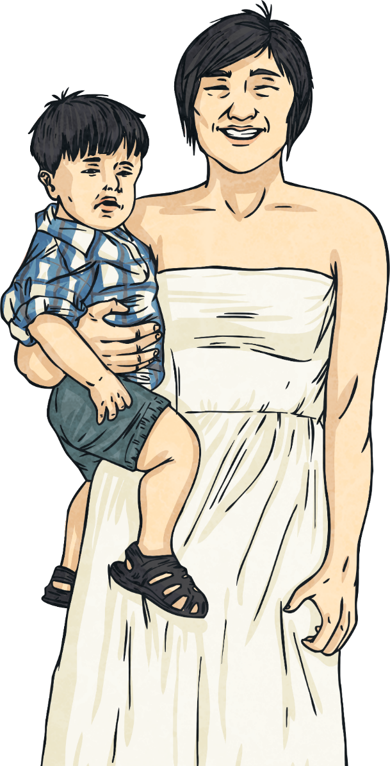
Traditions of Hinamatsuri Dolls
Dolls are often displayed a few days before the 3rd of March as they are believed to ward off evil spirits and bring good luck and prosperity. According to tradition, if the dolls are displayed after the 4th of March, a girl’s chances of marriage can be harmed. Although many families don’t believe this superstition, dolls are often quickly packed up after the festival for this reason. The display of hinamatsuri dolls will often end when a girl turns ten years old.

Slide 8
Traditions of Hinamatsuri Dolls
In ancient times, misfortunes and sin were transferred to a doll that was then discarded by throwing it into a river. This custom was thought to release bad luck and negative energy. Doll floatings, also known as hina-okuri (ひなおくり) or nagashi-bina (ながしびな), are still a common event in Japan and traditionally held late in the afternoon of the 3rd of March. At these ceremonies, dolls made from paper or straw are sent down the river on small boats.

Slide 9
Hinamatsuri Decorations
In the days leading up to Hinamatsuri, girls will often hold parties with their friends. Sprigs of peach blossoms and hanging ornaments known as tsurushi-bina (つるしびな), made from silk and threads, are often displayed near the hinakazari. These decorations will often feature rabbits, monkeys, fish and dolls as lucky symbols of happiness and growth.

Slide 10
Hinamatsuri Foods
As with most Japanese festivals and events, there are many traditional foods that are enjoyed during the celebration.
hina-arare | ひなあられ | Multi-coloured rice crackers
chirashizushi | ちらしずし | Scattered sushi
ichigo daifuku | いちご だいふく | Strawberry Mochi
shirozake | しろざけ | White sake (non-alcoholic)
ushiojiru | うしおじる | Clam soup

Slide 11
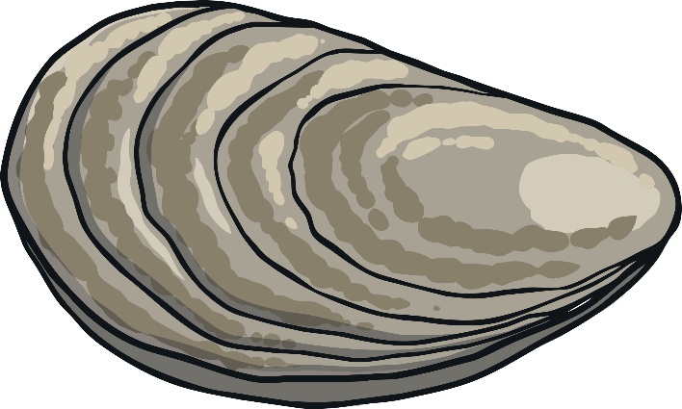
Hinamatsuri Games and Songs
Kai-awase (かい: clam; あわせ: matching) is a traditional game originally played in the Heian era. The goal of the game is to match two halves of a clam shell, which are decorated elaborately. This game, similar to Memory, is a very typical part of Hinamatsuri celebrations.
It is also customary to sing ‘Happy Hinamatsuri’, or ‘うれしい ひなまつり’ as part of the celebrations.

